Slide 1


Java Basics
Archer Infotech , PUNE
www.archerinfotech.in

Slide 2
What is JDBC ?
JDBC is one of the standard Java API for database-independent connectivity between the Java programming language and a wide range of databases.
This API lets you encode the access request statements, in Structured Query Language (SQL). This mainly involves opening a connection, creating a SQL Database, executing SQL queries and then arriving at the output.
JDBC API can be used to access tabular data stored in any relational database. With this, you can update, save, fetch and delete the data from the databases.
It is similar to the Open Database Connectivity (ODBC) provided by Microsoft.

Slide 3
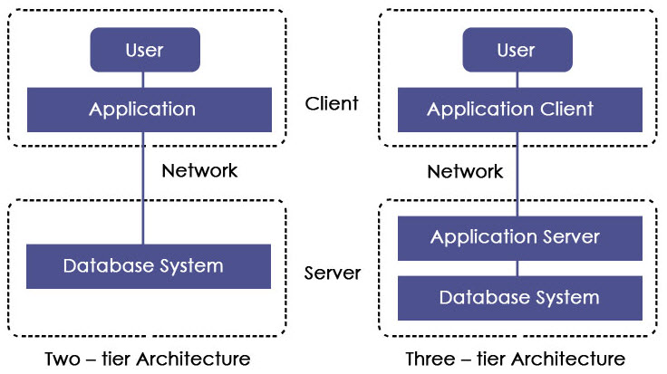
JDBC Architecture

Slide 4
JDBC Architecture
1. Two-tier Architecture
This architecture helps java program or application to directly communicate with the database. It needs a JDBC driver to communicate with a specific database. Query or request is sent by the user to the database and results are received back by the user. The database may be present on the same machine or any remote machine connected via a network. This approach is called client-server architecture or configuration.
2. Three-tier Architecture
In this, there is no direct communication. Requests are sent to the middle tier i.e. HTML browser sends a request to java application which is then further sent to the database. Database processes the request and sends the result back to the middle tier which then communicates with the user. It increases the performance and simplifies the application deployment.

Slide 5
JDBC Components
Driver Manager: It is a class that contains a list of all drivers. When a connection request is received, it matches the request with the appropriate database driver using a protocol called communication sub-protocol. The driver that matches is used to establish a connection.
Driver: It is an interface which controls the communication with the database server. DriverManager objects are used to perform communication
.
Connection: It is an interface which contains methods to contact a database.
Statement: This interface creates an object to submit SQL queries or statements to the database.
ResultSet: This contains the results retrieved after the execution of the SQL statements or queries.
SQLException: Any errors that occur in database application are handled by this class.

Slide 6
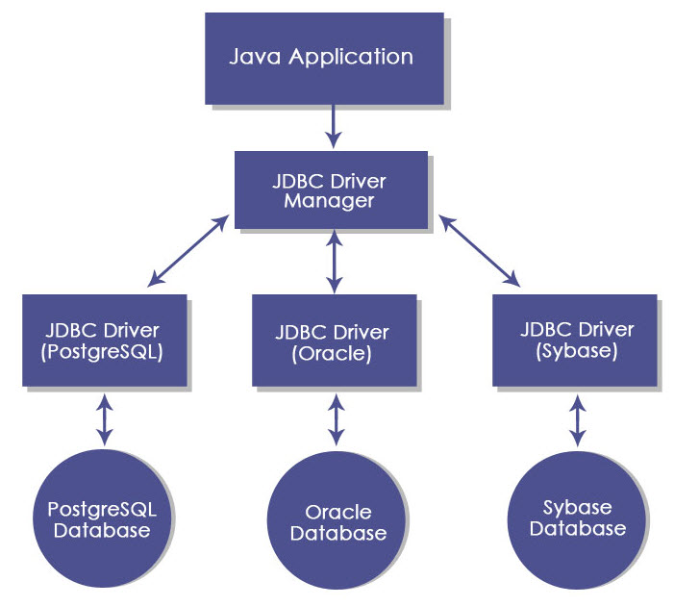
JDBC Components

Slide 7
JDBC Interfaces
Driver Interface: This interface allows for multiple database drivers. DriverManager objects are created to communicate with the database. These objects are created by DriverManager.registerDriver();
Connection Interface: Connection interface establishes the connection i.e. session between java program and the database. It has many methods like rollback(), close() etc.
Statement Interface: This interface provides methods for the execution of the SQL queries. It provides factory methods to get a ResultSet object. Some methods of statement interface are executeQuery(), executeUpdate() etc.
PreparedStatement Interface: This interface helps when the SQL queries need to implement many times. It accepts input parameters during runtime.
CallableStatement Interface: This interface is used when stored procedures are to be accessed. It also accepts parameters during run time.
ResultSet Interface: This interface helps to store the result returned after the execution of the SQL queries.

Slide 8
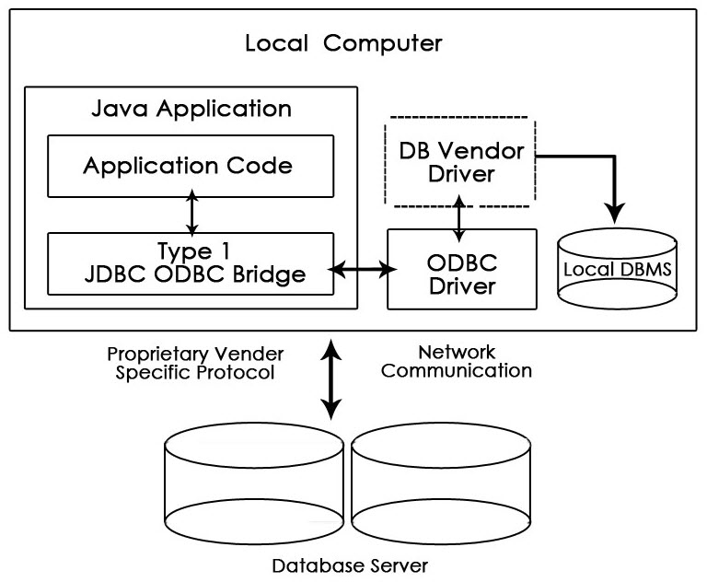
JDBC Driver Types
1. Type-1 Driver or JDBC-ODBC Bridge

Slide 9
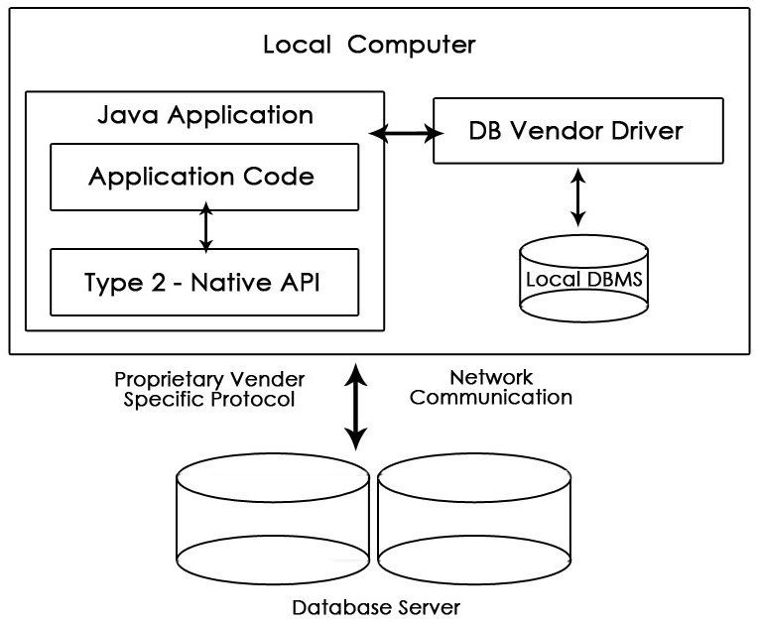
JDBC Driver Types
2. Type-2 Driver or Native API Partly Java Driver
This driver uses JNI (Java Native Interface) call on database specific native client API. It is comparatively faster than Type-1 driver but it requires native library and cost of application also increases.

Slide 10
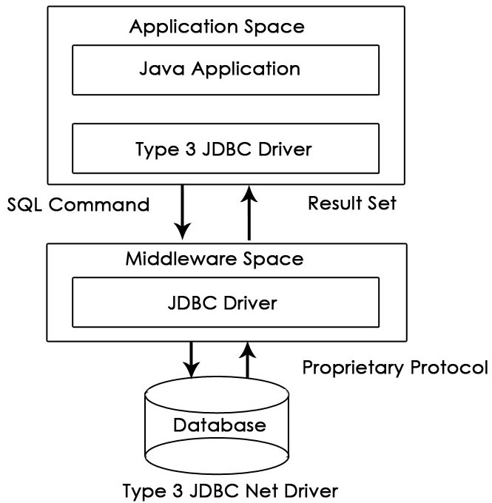
JDBC Driver Types
3. Type-3 Driver or Network Protocol Driver
These drivers communicate to JDBC middleware server using proprietary network protocol. This middleware translates the network protocol to database specific calls. They are database independent. They can switch from one database to another but are slow due to many network calls.

Slide 11
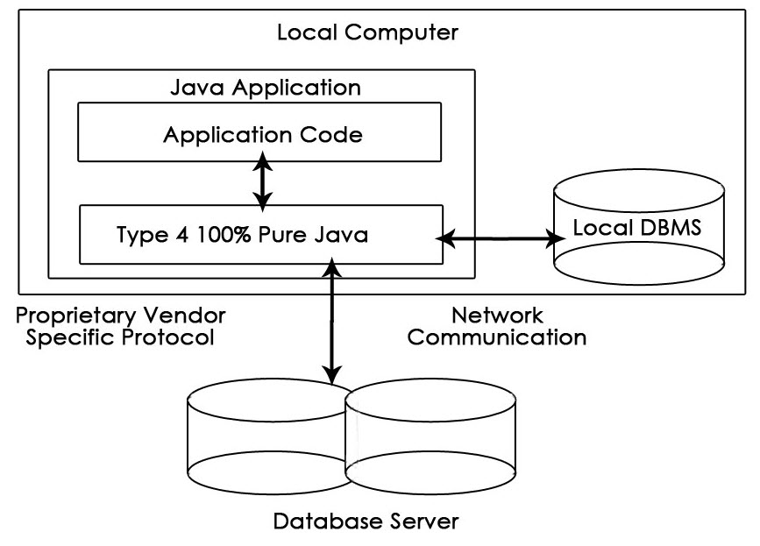
JDBC Driver Types
4. Type-4 or Thin Driver
This driver is also called pure Java driver because they directly interact with the database. It neither requires any native library nor middleware server. It has better performance than other drivers but comparatively slow due to an increase in a number of network calls.

Slide 12
Steps to Create JDBC Application
Import the packages: You need to include all the packages that contain the JDBC classes needed for database programming. Most often, using import java.sql.* will suffice.
Register the JDBC driver: Here you have to initialize a driver so that you can open a communication channel with the database.
Open a connection: Here, you can use the getConnection() method to create a Connection object, which represents a physical connection with the database.
Execute a query: This actually requires to use an object of type Statement for building and submitting an SQL statement to the database.
Extract data from the result set: It is suggested that you use the appropriate getXXX() method to retrieve the data from the result set.
Clean up the environment: Here, it is essential to explicitly close all database resources versus relying on the JVM’s garbage collection.

Slide 13
Register Driver
Register JDBC Driver: This step causes the JVM to load the desired driver implementation into memory so that it can fulfill your JDBC requests. There are 2 approaches to register a driver.
The most common approach to register a driver is to use Java’s forName()method to dynamically load the driver’s class file into memory, which automatically registers it. This method is preferable because it allows you to make the driver registration configurable and portable. Refer the below code.
Class.forName("oracle.jdbc.driver.OracleDriver");
The second approach you can use to register a driver is to use the static registerDriver()method.
Driver myDriver = new oracle.jdbc.driver.OracleDriver();
DriverManager.registerDriver( myDriver );

Slide 14
Database URL Formulation
Database URL Formulation: This is to create a properly formatted address that points to the database to which you wish to connect. After you’ve loaded the driver, you can establish a connection using the DriverManager.getConnection() method.
DriverManager.getConnection() methods are−
getConnection(String url)
getConnection(String url, Properties prop)
getConnection(String url, String user, String password)

Slide 15
Java Database URL for SQL Server
The syntax of database URL for SQL Server is as follows:
jdbc:sqlserver://[serverName[\instanceName][:portNumber]][;property=value[;property=value]]
Where:
serverName: host name or IP address of the machine on which SQL server is running.
instanceName: name of the instance to connect to on serverName. The default instance is used if this parameter is not specified.
portNumber: port number of SQL server, default is 1433. If this parameter is missing, the default port is used.
property=value: specify one or more additional connection properties. To see the properties specific to SQL server, visit Setting the Connection Properties.

Slide 16
JDBC Statement Types
Interfaces | Recommended Use
Statement | This interface is generally used in order to get the general-purpose access to the user's database database. It has been proven useful when the users are using static SQL statements at the runtime. Parameters are generally not accepted by the Statement interface.
PreparedStatement | This interface is generally used when the user plans to use the SQL statements several times. The PreparedStatement interface generally accepts the input parameters at runtime.
CallableStatement | This interface is generally used when the user want to access the database stored procedures. The CallableStatement interface is also known to accept runtime input parameters.

Slide 17
JDBC Result Set Types
Type | Description
ResultSet.TYPE_FORWARD_ONLY | In this type the cursor can basically move forward in the result set only.
ResultSet.TYPE_SCROLL_INSENSITIVE | In this type, the cursor can basically scroll forward and backward and the best part is that the result that is set is not sensitive to the changes that are made by the others to the database that happens after the result set was even created.
ResultSet.TYPE_SCROLL_SENSITIVE. | In this type, the cursor can basically scroll only forward and backward and the thing that is concerning here is that the result set is sensitive to the changes that have been made by the others to the database that generally occur after the result set was created.

Slide 18
THANK YOU !!!

